Slide 1
The CEPC-SppC Study Group
Status Report
XinChou Lou
Institute of High Energy Physics
Beijing, China
On Behalf of the CEPC-SppC Study Group

Slide 2
Outline
• CEPC+SppC a Higgs factory and a high energy pp collider
• Organization
• PRE-CDR physics, feasibility, technology, design,
schedule, cost estimate
• Current status
theory, accelerator, detector,
site consideration, civil engineering,
worldwide effort, etc.
• Prospects

Slide 3
CEPC Study Group

Slide 4
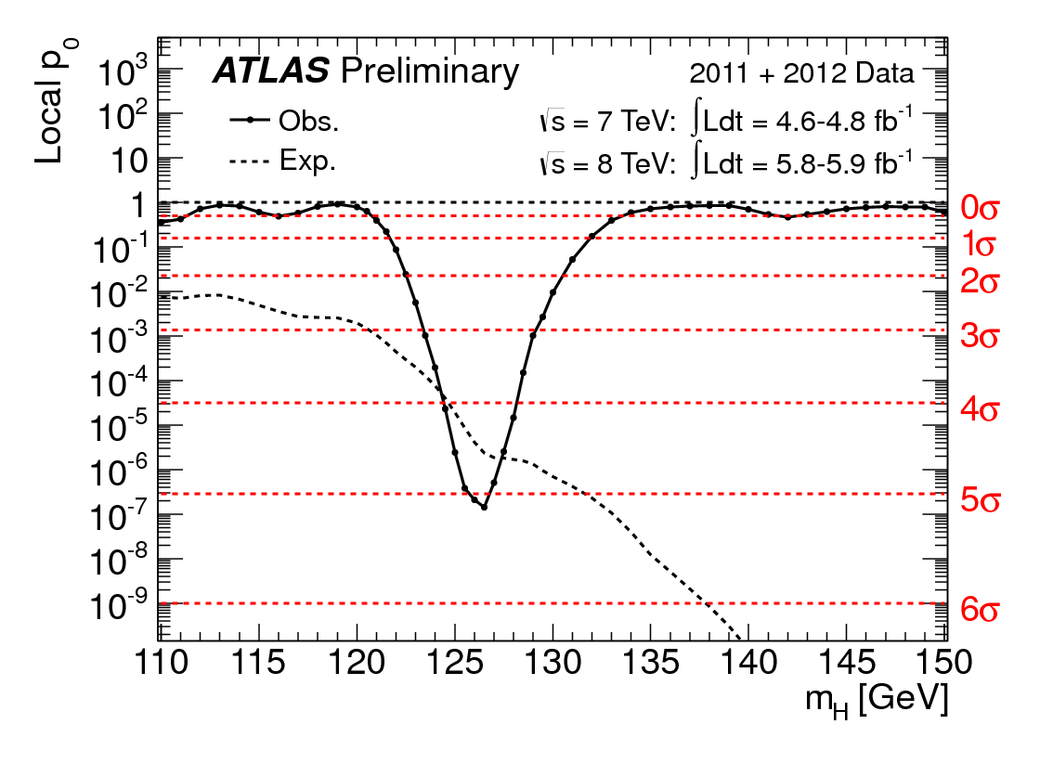
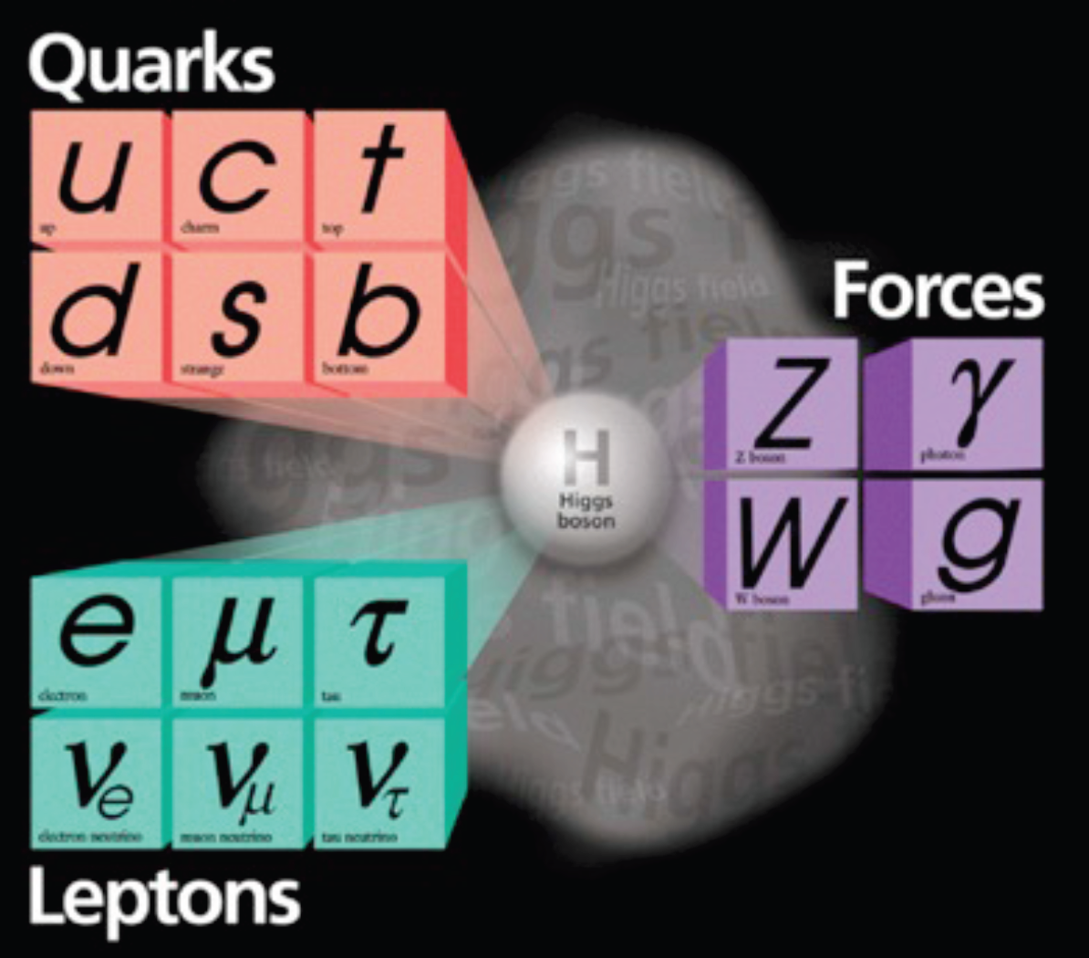
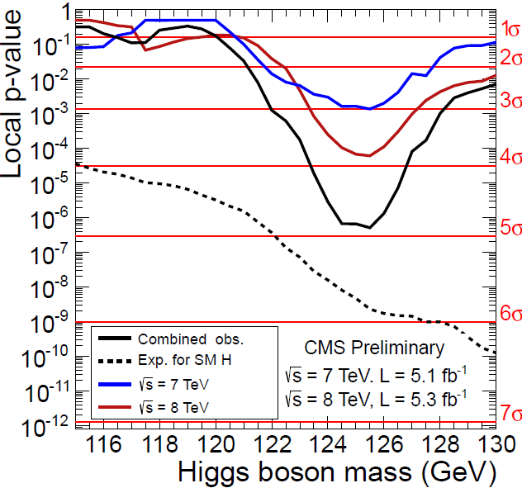
CEPC
“low Higgs mass makes the circular e⁺e⁻ collider as a viable option”
a new fundamental particle: light, weakly coupling H:
M_{h}=125-126 GeV, Γ<1 GeV, spin 0 (first)
July 4, 2012
5σ
4.9σ
What is it? How does it behave? New physics?

Slide 5
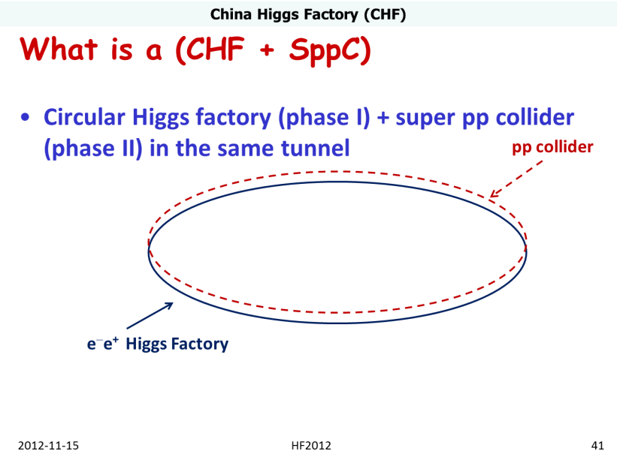
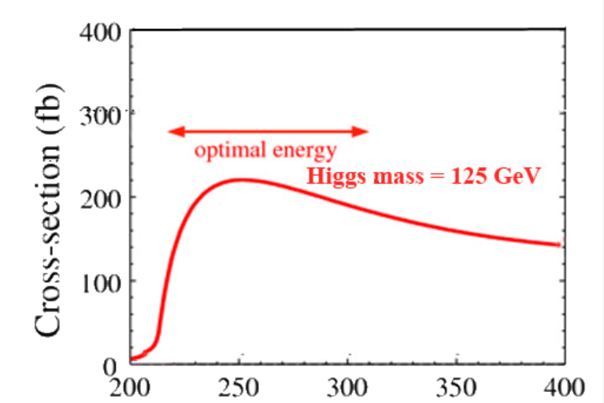
CEPC-SppC
Phase 1: e⁺e⁻ Higgs (Z) factory
E_{cm}≈240GeV, luminosity ~2×10³⁴ cm⁻²s⁻¹, can also run at the Z-pole
精确测量希格斯玻色子性质， Z玻色子精确测量
Phase 2: a discovery machine; pp collision with E_{cm} ≈ 50-100 TeV; ep option
物理目标是发现BSM新物理
e⁺e⁻ → ZH
Q. Qin
BEPCII后中国粒子物理加速器候选项之一
E_{cm}(GeV)

Slide 6
CEPC Organization

Slide 7
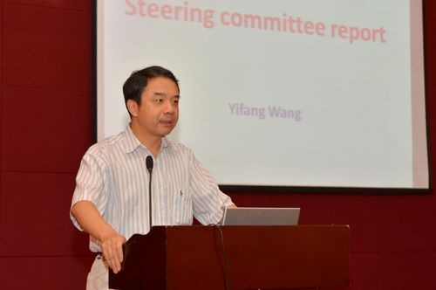
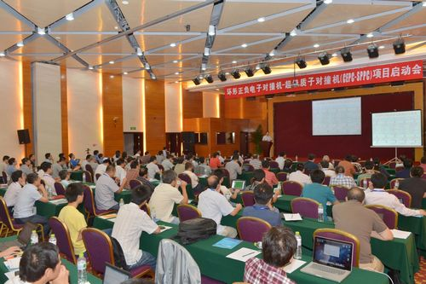
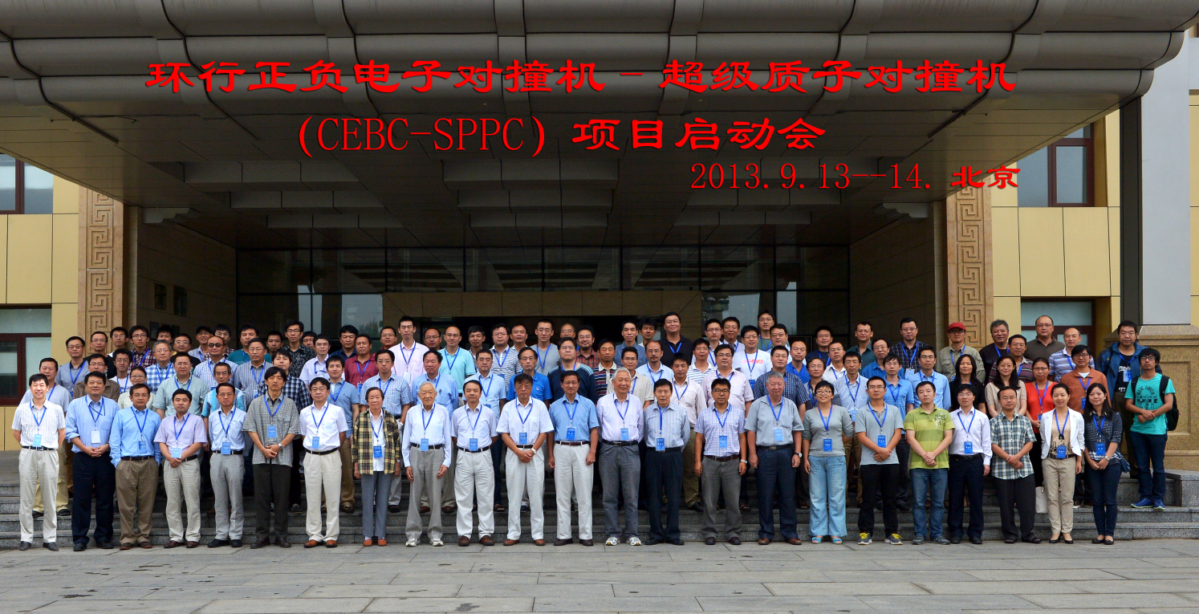
CEPC Kick-off Meeting
The Chinese CEPC+SppC Study Group kick-off meeting took place Sept. 13-14,2013
Participation by over 120 physicists
Domestic accelerator, theoretical and experimental physicists were organized

Slide 8
CEPC组织结构
CEPC Organization –
Institutional Board:
chairman: GAO Yuanning (Tsinghua U); 1 rep. per institution
deputy chairman: GAO Jie (IHEP)
Steering Committee:
chairman WANG Yifang (IHEP);
Project directors: LOU Xinchou (IHEP), QIN Qing (IHEP)
Working groups:
Theory (Conveners: HE Hong-jian, ZHU Shouhua)
Accelerator (Conveners: QIN Qing, GAO Jie)
Detector (Conveners: JIN Shan, GAO Yuanning)
Monthly Steering Committee + Conveners meetings
2-3 workshops per year

Slide 9
PRE-CDR 初步概念设计
getting preliminary answers to critical questions
document ready for 13th 5 Year Plan (2015)

Slide 10
PRE-CDR
Pre-CDR (by end of 2014)
main physics topics and motivations;
initial collider design(s);
detector technologies and conceptual configuration
core physics sensitivity (initial)
site requirement, reality check on civil engineering
crude cost estimates
etc.
Established persons in charge of the Pre-CDR writing
Theory – Hong-jian He（Tsinghua）, Shouhua ZHU（PKU） and
Nima Arkani-Hamed （Princeton）
Accelerator – Weiren Chou（Fermi Lab）
Detector & Simulation – Yuanning GAO（Tsinghua）
Civil Engineering & Support – Zhao Jingwei (IHEP)

Slide 11
PRE-CDR 初步概念设计
THEORY

Slide 12
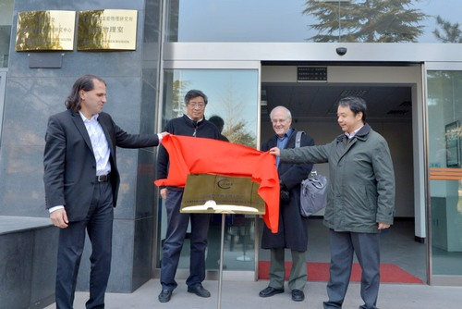
Center for Future High Energy Physics
Aiming at “world class particle physics”
“CFHEP” is established at IHEP
Prof. Nima Arkani-Hamed is now the director
Many theorists (coordinated by Nima and Tao Han) and accelerator physicists(coordinated by Weiren Chou) from all the world have signed to work here from weeks to months.
Current work:
Workshops, seminars, public lectures, working sessions, …
Pre-CDR
Future works (with the expansion of CFHEP to include Exp. & more Acc.)
CDR & TDR
Engineer design and construction
A seed for an international lab ➔
For the world’s HEP community
First Charge:
Physics Cases for PRE-CDR

Slide 13

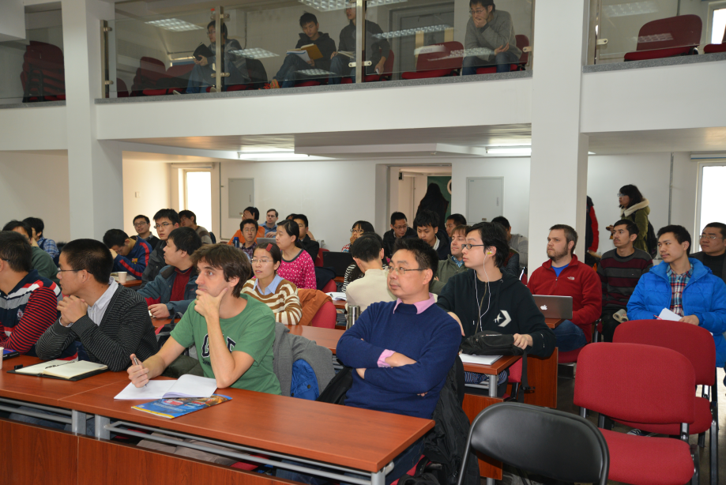
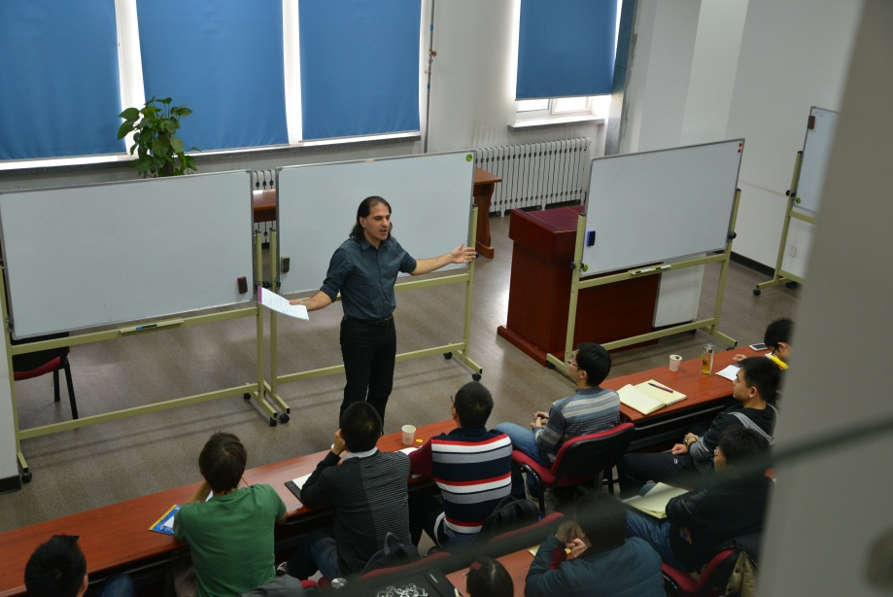
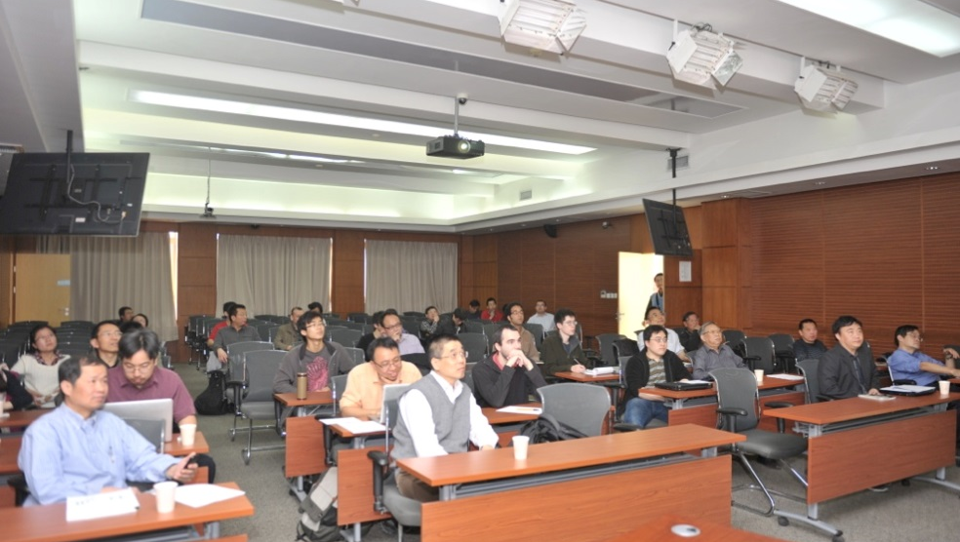
Center for Future High Energy Physics
高能物理前沿研究中心协助清华大学召开了“希格斯粒子之后，基础物理学向何处去”的论坛，600多人参加。
到目前为止的两个月的时间内，已经有29人次在中心访问。每个礼拜都会去清华、北大或者理论所访问。
每周至少两次seminar，一天去国内其它研究所或者大学访问，例如：4月2号，李田军和杨金民在理论所组织了SUSY的讨论会。
C. D. Lv

Slide 14
THEORY Preliminary Conceptual Design Report
Higgs Physics
Introduction
Theoretical Overview
Prospects for Higgs Measurements at the LHC
Higgs Physics at the CEPC
High Energy Upgrades: the SppC
SM Physics
Beyond Standard Model: Supersymmetry
Beyond Standard Model: Alternatives
Flavor physics
TeV Cosmology
Dark matter
Electroweak baryognesis
Heavy Ion Physics
Monte Carlo Tools

Slide 15
PRE-CDR 初步概念设计
ACCELERATOR

Slide 16
CEPC Preliminary Conceptual Design Report
Introduction
CEPC - machine layout and performance
CEPC – technical systems
CEPC – injectors
Upgrade to SppC
Key accelerator physics issues
Key technical systems
Reconfiguration of the accelerator complex
Alternative designs
Limited scale Higgs factory
ep
γγ
Civil construction
Environment, safety and health considerations
R&D programs
Project plan and cost estimates

Slide 17
CEPC – current accelerator status
Weiren Chou (Fermi Lab) is spending a year at IHEP
Is in charge of the CEPC-SppC PRE-CDR writing
Arranges world’s accelerator experts to come to Beijing to contribute
Bring staff and students on board doing real work
Train IHEP staff in proton accelerator technology
Organize ICFA workshop on circular collider workshop (October 2014)
Facilitates communications with others
April Visitor’s Schedule
Name | Institution | Specialty | Dates
Dmitry Shatilov | BINP (Russia) | Beam-beam | April 1-16
Dick Talman | Cornell U. (USA) | General | April 13 - May 15
Yoshihiro Funakoshi | KEK (Japan) | Parameters, injection, background | April 1-15
Kazuhito Ohmi | KEK (Japan) | Beam-beam, e-cloud | April 13-25
Armen Apyan | Northwestern U. (USA) | CAIN/Guinea-Pig, polarized e+, beam dump | March 31 - April 30
Yunhai Cai | SLAC (USA) | Lattice, interaction region | April 15-30
Yuhong Zhang | Jlab (USA) | ep collider | April 13 - May 10

Slide 18
CEPC – current accelerator status
e+e- collider as a Higgs factory
Beam energy ~ 120 GeV
Synchrotron radiation power ~50 MW
50 in circumference (two options)
Proton-proton collider
Beam energy ~50-100 TeV
50 or 70 km in circumference
Superconducting, high-field magnets (~20T)
base line

Slide 19
CEPC – current accelerator status
Main ring:
A FODO lattice in arcs with 60 degree phase advances
16-folder symmetry
RF sections distribute around the ring
f_{rf} = 700MHz is chosen
Pretzel scheme is adopted for multi-bunch collision
Double ring option is under-investigation
ATF2 type and ILC type FFS designs are currently under study
Booster:
In the same tunnel of the collider (6 – 120 GeV)
Linac:
6 GeV–Linac will be adopted

Slide 20
CEPC – current accelerator status
preliminary parameters
Accelerator Parameters
Beam energy [E] | GeV | 120
Circumference [C] | km | 53.6
Luminosity [L] | cm⁻²s⁻¹ | 1.82E+34
SR power/beam [P] | MW | 50
Bending radius [ρ] | m | 6094
NIP |  | 2
nB |  | 50
filling factor [κ] |  | 0.71
Lorentz factor [γ] |  | 234834.66
Revolution period [T0] | s | 1.79E-04
Revolution frequency [f0] | Hz | 5591.66
Magnetic rigidity [Bρ] | T·m | 400.27
momentum compaction factor [αp] |  | 4.15E-05
Energy acceptance Ring[η] |  | 0.02
cross-section for radiative Bhabha scattering [σee] | cm² | 1.53E-25
lifetime due to radiative Bhabha scattering [τ_{L}] | min | 55.42
build-up time of polarization [τ_{p}] | min | 21
 | input
 | calculated
 | simulation results

Slide 21
PRE-CDR 初步概念设计
Detector & Simulation

Slide 22
CEPC – Detector Considerations
baseline detector configuration & conceptual choice for detector components
sensitivities of Higgs measurement relative to LHC and ILC
design and optimization considerations
Benefit greatly from the work done with the ILC
Start with the ILD
Adopt the detector technologies and basic layout
detector operates without the power pulsing
vary detector geometries
implement simulation to evaluate the detector performance
at the CEPC and do the cost estimates

Slide 23
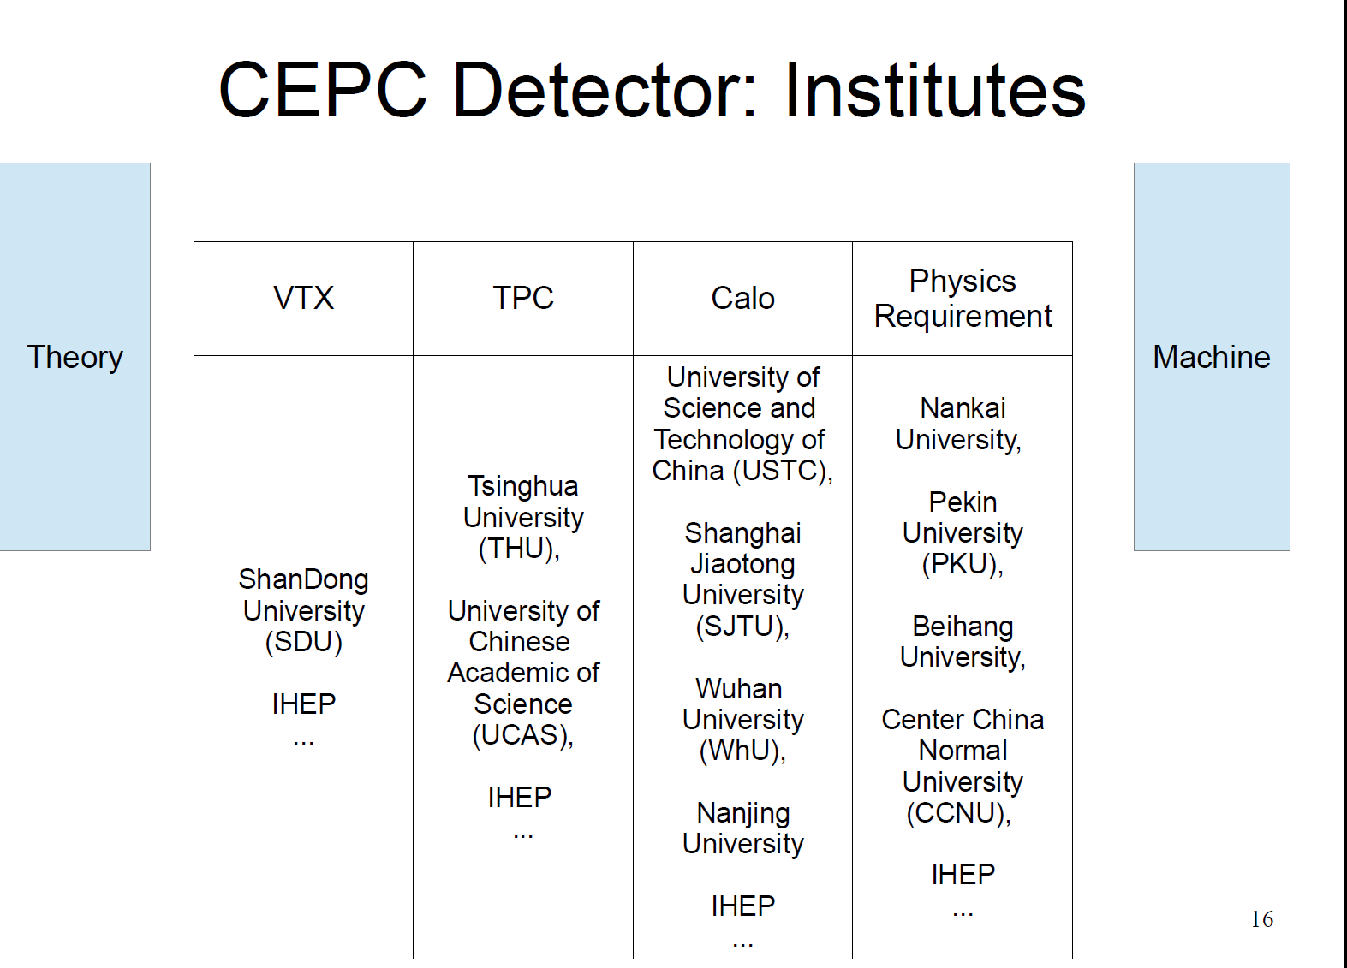
CEPC – Detector Considerations
M. Q. Ruan

Slide 24
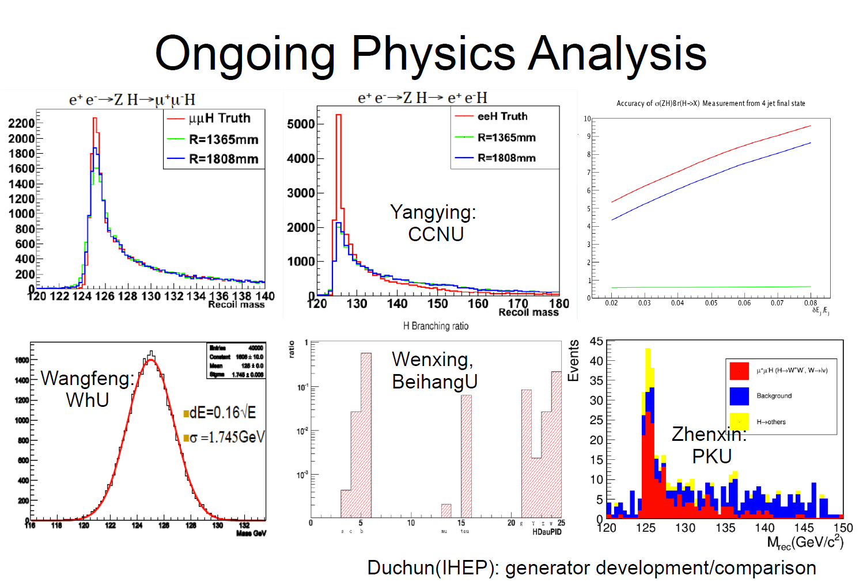
CEPC – Detector Considerations
M. Q. Ruan

Slide 25
CEPC-SppC Detector & Technology Considerations
critical technologies: activities and plan
High field superconducting magnets for SppC
Silicon pixel-strip detectors and ASIC electronics
High performance calorimeters: ECAL and HCAL
Trigger, data flow and computing
Also need sustained, advanced ATF facility and staff
M. Q. Ruan

Slide 26
PRE-CDR 初步概念设计
Site Consideration & Civil Engineering

Slide 27
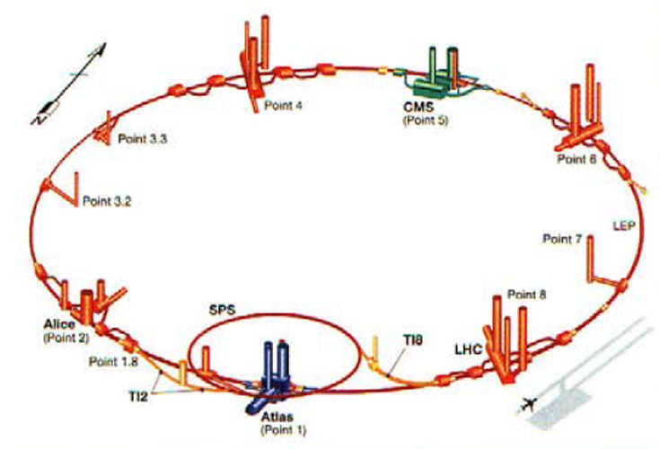
实验场地考虑
高能所玉泉路 园区有限，不满足未来大设施 需要
华北是否有合适建造地下大型加速器的场地？
场地是否满足建立大型国际化实验中心的条件？
地方政府的支持力度？
高能所组织考察了14 场地（河北，河南），调查地下结构。
以河北秦皇岛为例 --
Notes:
施工方法

Slide 28
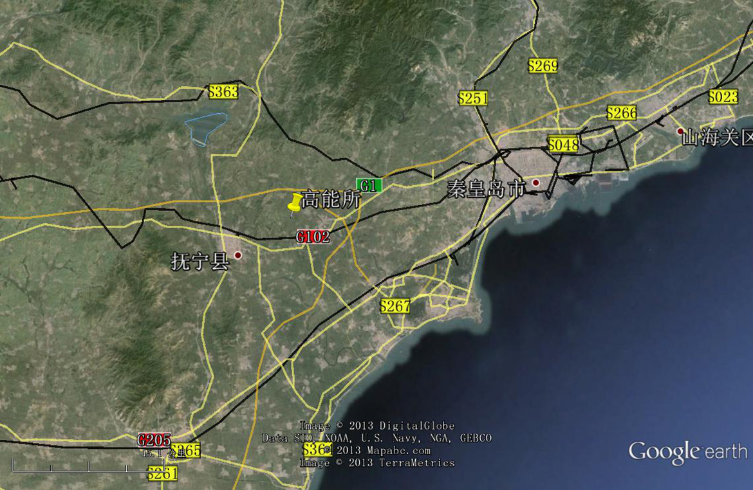
CEPC – Site Investigation
300 km from Beijing
3 hours by car; 1 hours by high speed train
A good example is 秦皇岛:
Y. F. Wang

Slide 29
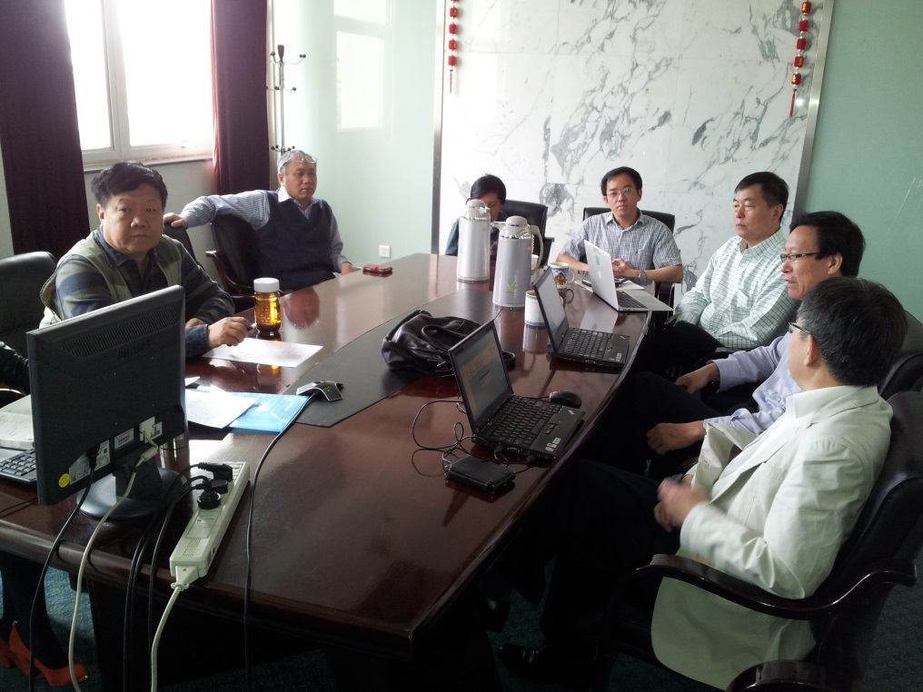
PRE-CDR Civil Engineering
IHEP Engineering & Support Group
地下隧道建设 –施工方法，防、排水，
通风，辐射防护，电子仪器厅，….
地面设施 – 实验厅，供电，制冷，消防，
交通，竖井，access points,
其他 – 节能减排，工期，整体造价
Baseline Consideration:
黄河勘测规划设计有限公司 –
秦皇岛抚宁地区为概念设计地点
C=50km圆环形隧道，截面直径R~6.5m，地下50-100m
倾斜度控制在4‰以内（便于排水）
节能减排：为节约能源，减少浪费，设法进行二次利用
在环形隧道地面设有5000亩办公园区
隧道供电负荷、区域变电站，园区需要若干小变电站
使用硬岩TBM或盾构机的比较造价清单
高能所 –
估算与制冷机配套的冷却塔占地面积
安排黄河公司对CERN LHC现场考察活动
提供给黄河公司有关的资料
双方确定交流会，保持及时沟通
Notes:
施工方法

Slide 30
PRE-CDR 初步概念设计
Timelines

Slide 31


CEPC Timeline (dream)
Pre-study, R&D and preparatory work
Pre-CDR (by end of 2014) to be ready by China 13th 5-year plan
Pre-study 2013-2015
R&D 2016-2020
Engineering Design 2015-2020
Construction: 2021-2027
Data taking: 2028-2035

Slide 32
SppC Timeline (dream)
Pre-study, R&D and preparatory work
Pre-study 2013-2020
R&D 2020-2030
Engineering Design 2030-2035
Construction: 2035-2042
Data taking: 2042 –

Slide 33


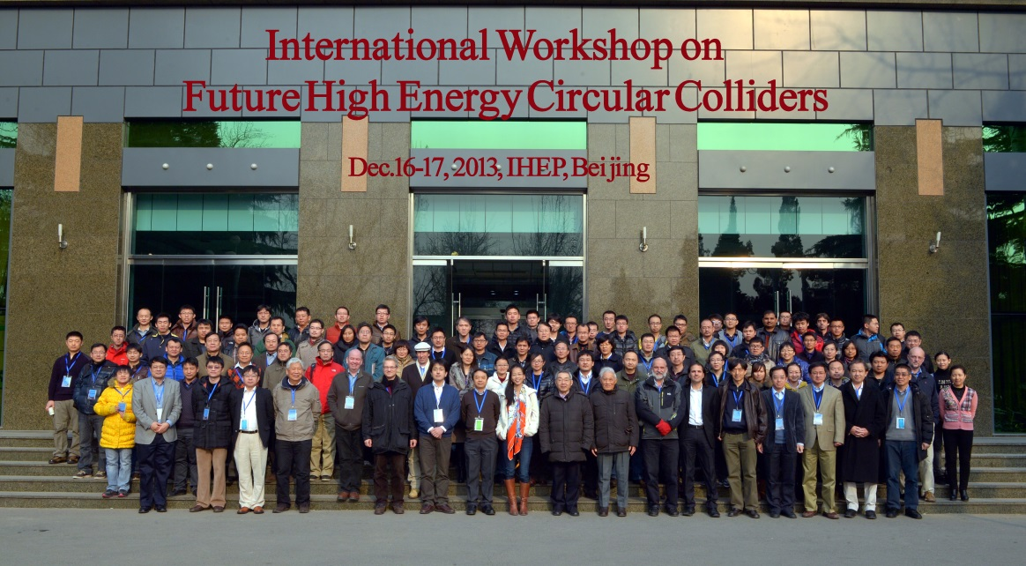
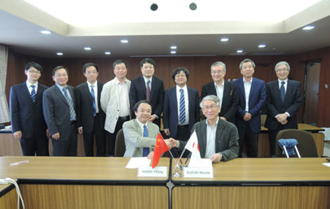

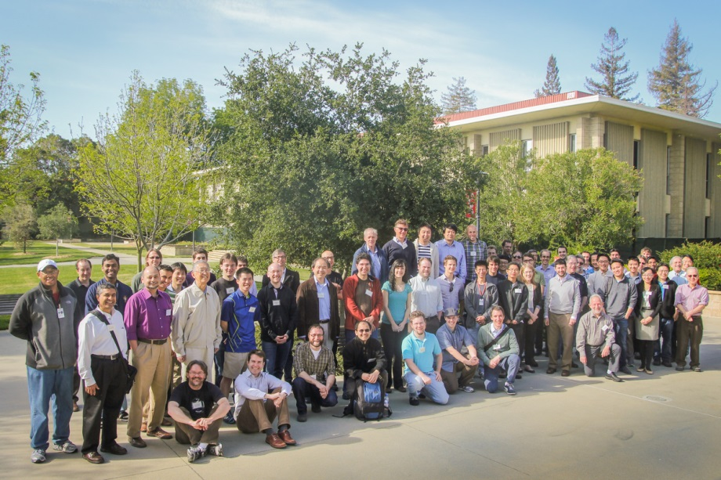
World Wide Effort
IHEP-KEK Annual Meeting
SLAC 100 TeV Workshop

Slide 34
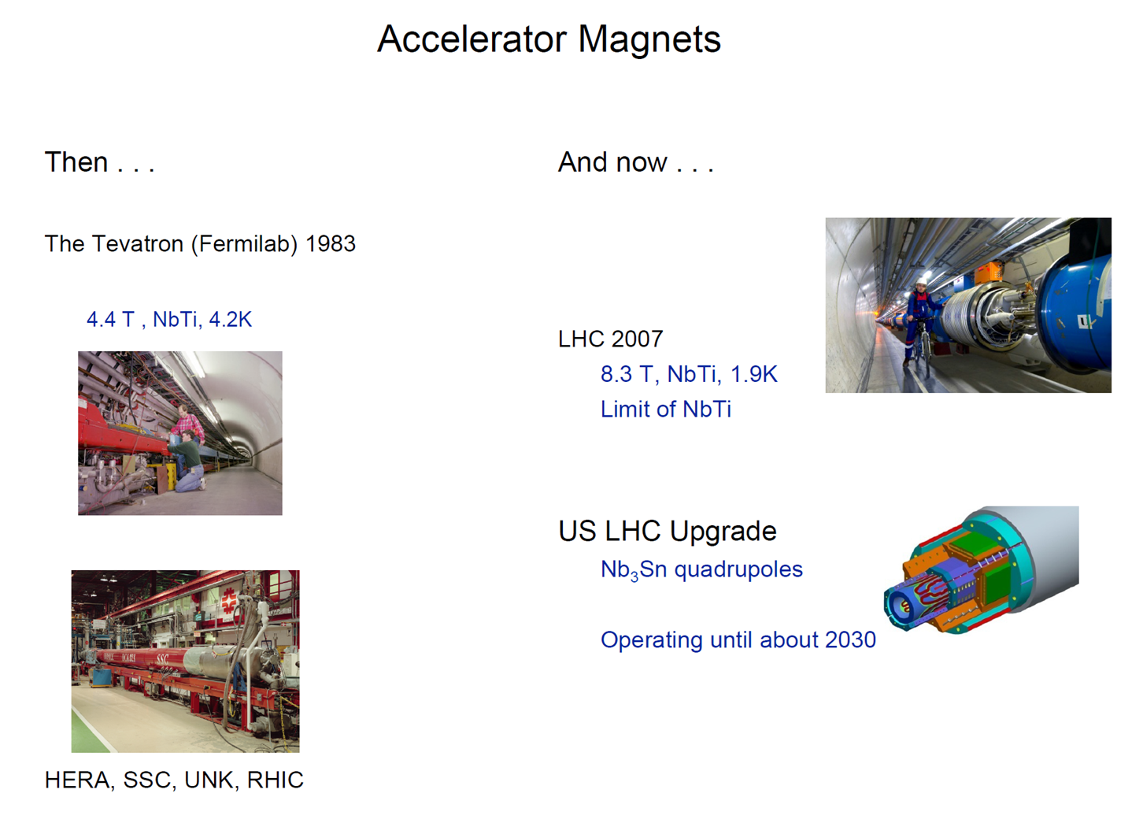
CEPC-SppC Detector & Technology Considerations
Steve Gourlay

Slide 35
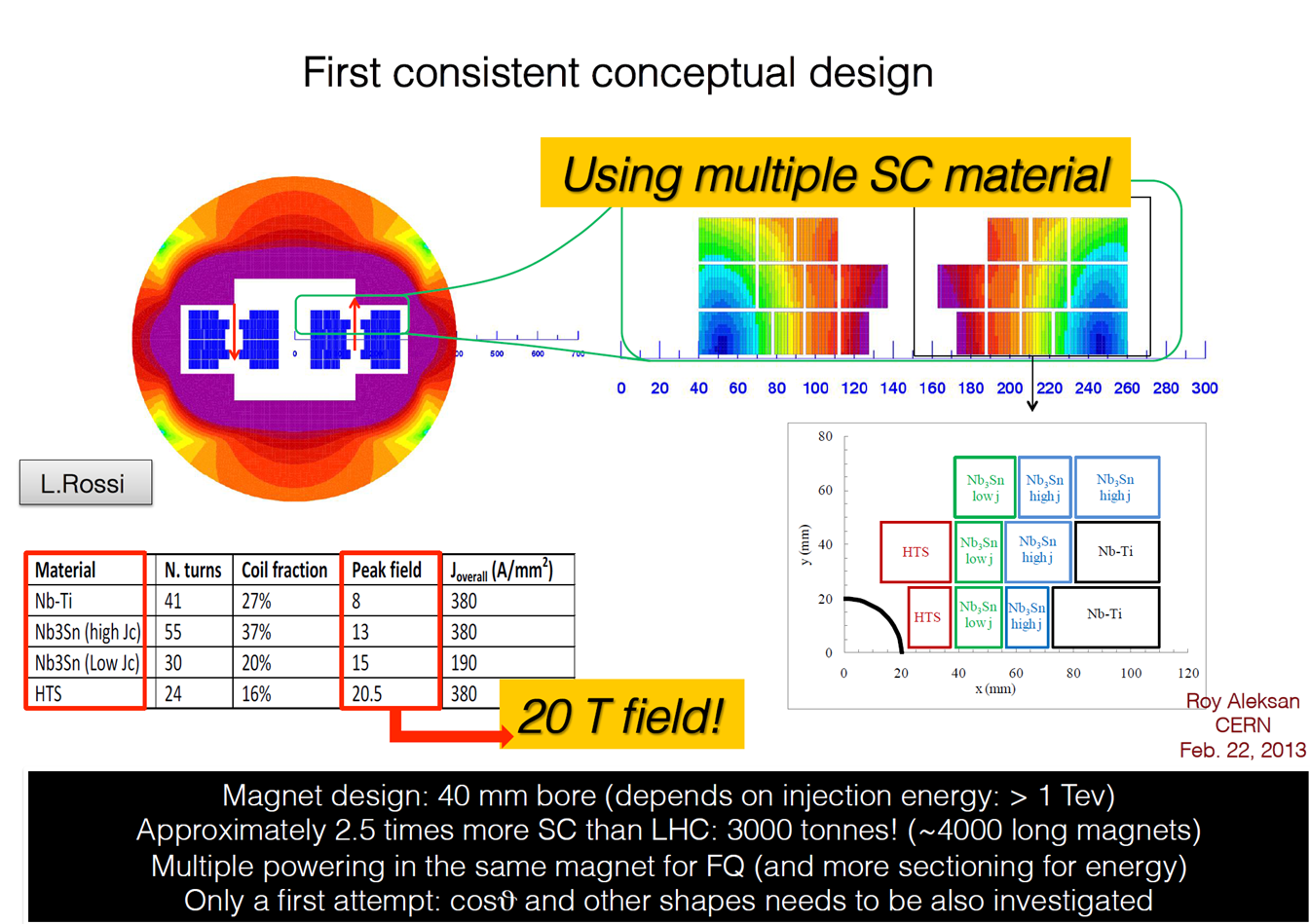

CEPC-SppC Detector & Technology Considerations
Go for 20 T

Slide 36
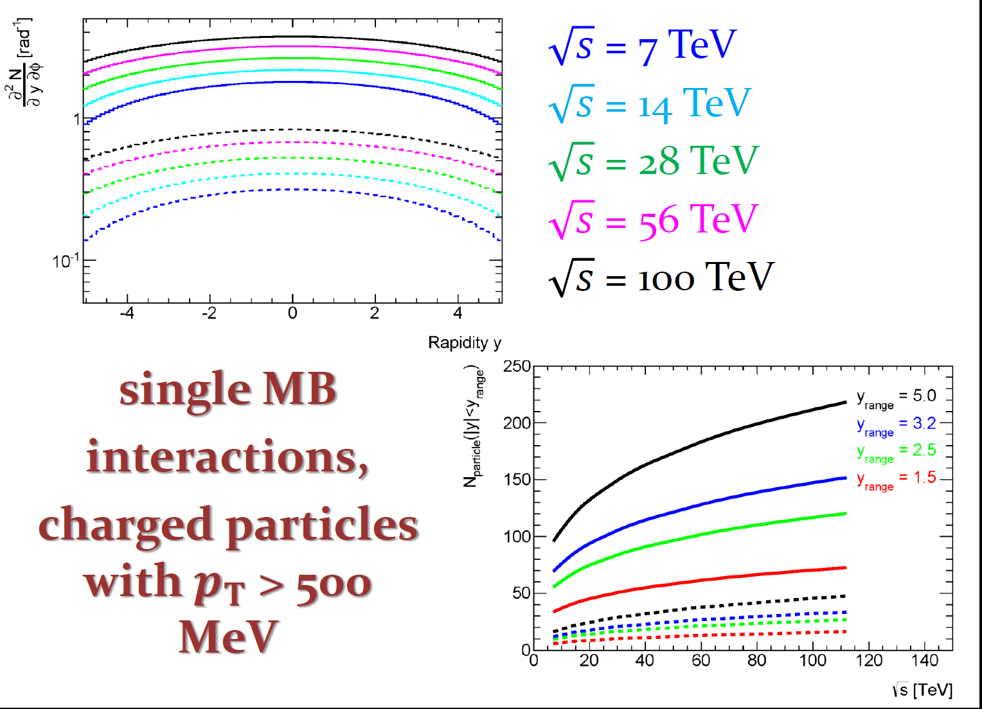
CEPC-SppC Detector & Technology Considerations
Multiplicities at 100 TeV
P. Loch

Slide 37
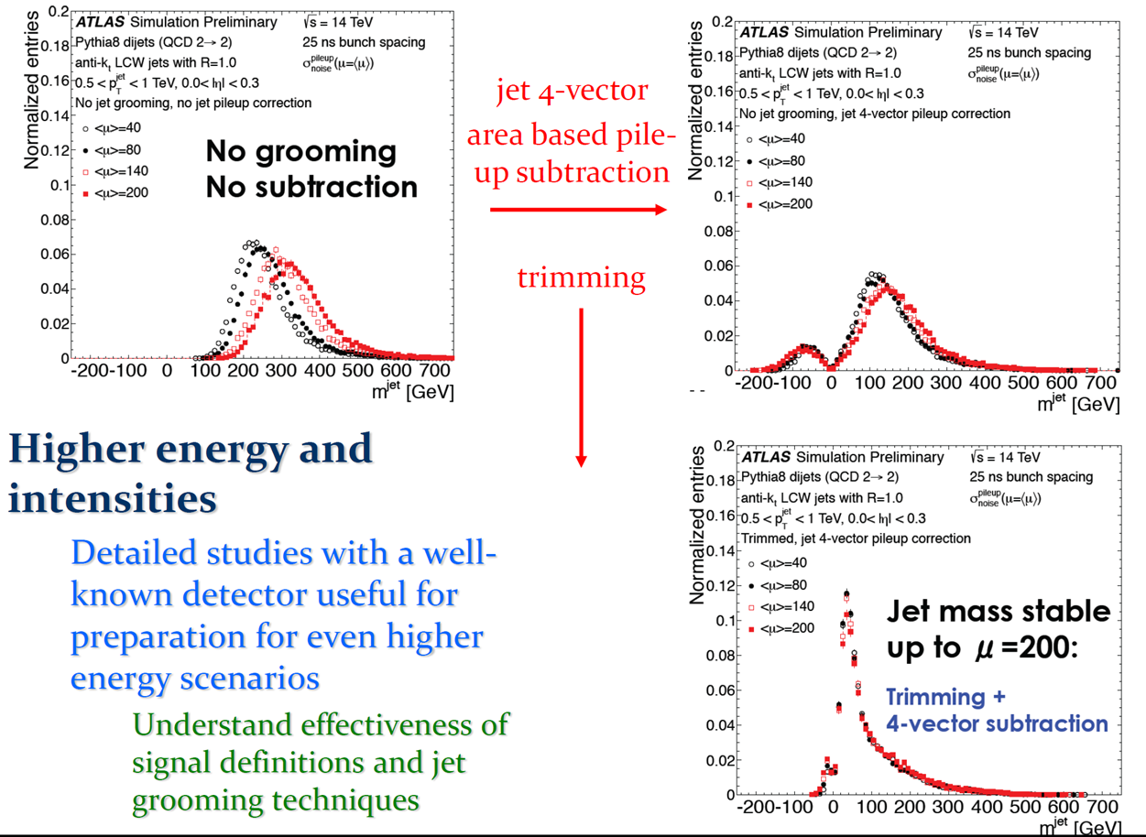
CEPC-SppC Detector & Technology Considerations
P. Loch

Slide 38
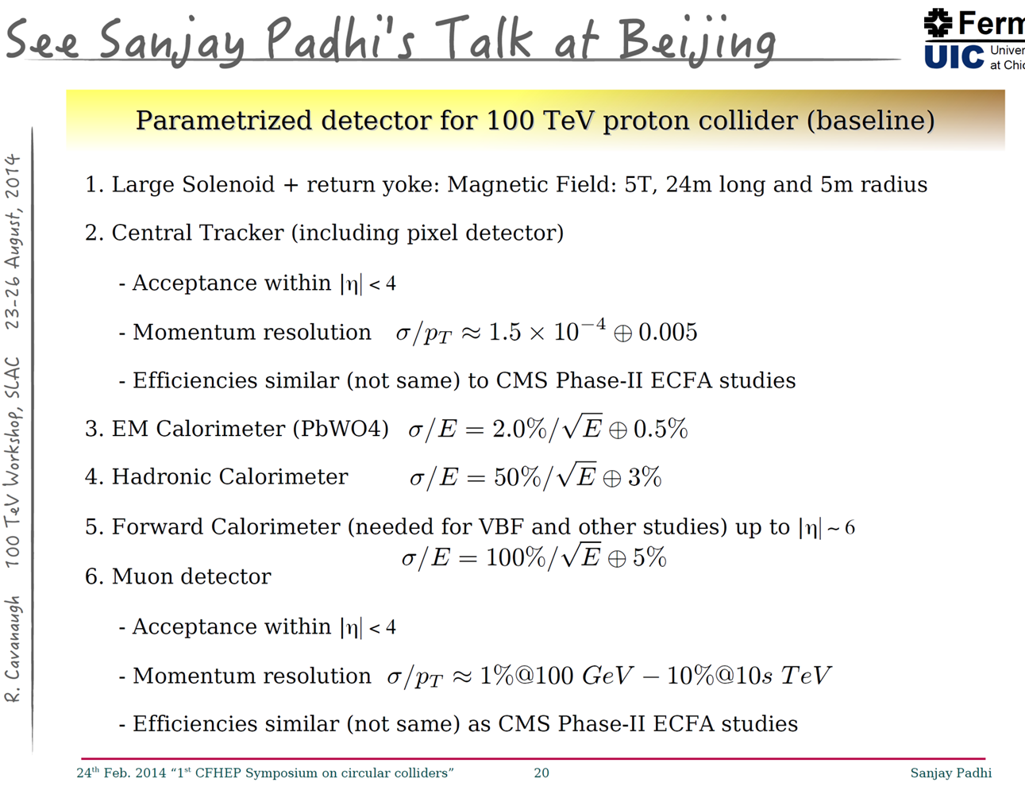
CEPC-SppC Detector & Technology Considerations

Slide 39
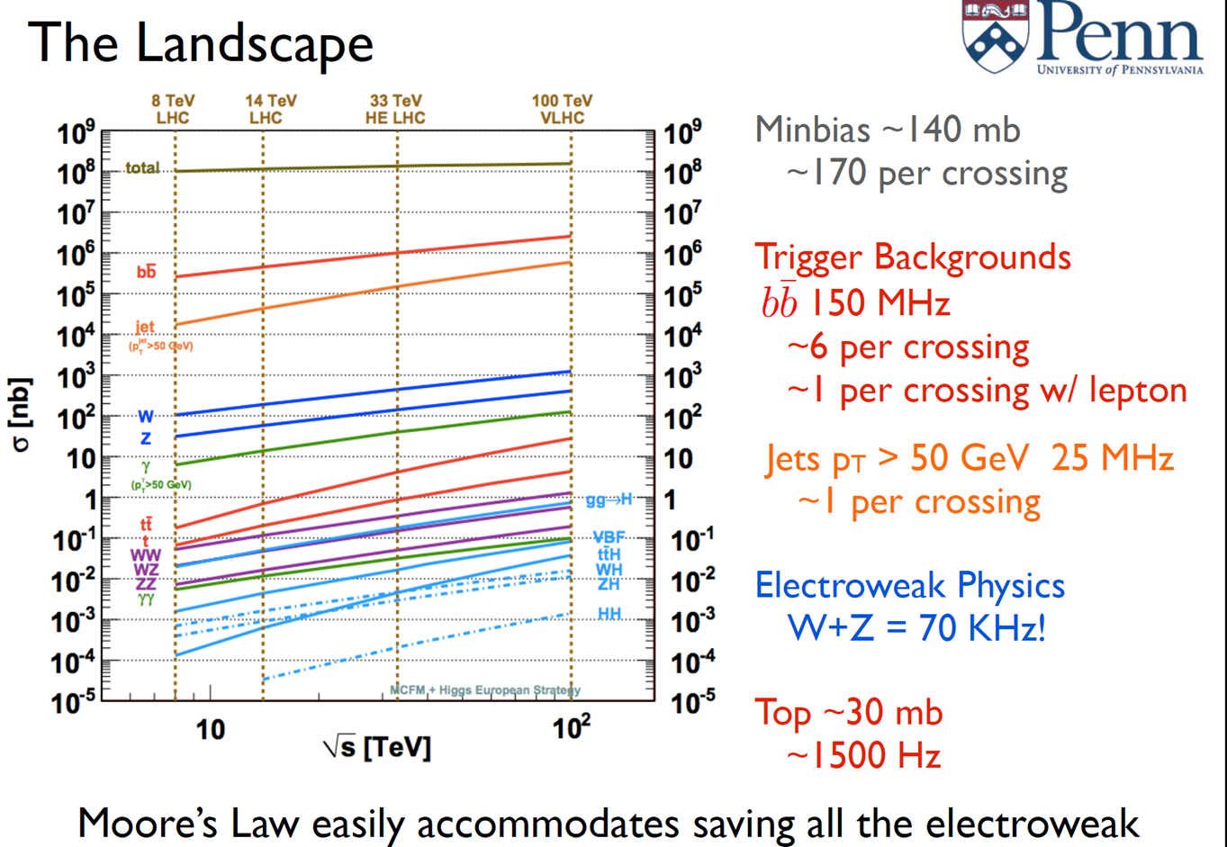
Trigger
Elliot Lipeles

Slide 40
CEPC – Prospects
Theory
➔ fully explore physics with the Higgs boson &
in the energy frontier
Detector: benefits from ILC, FCC, LHC experiments + own effort
➔ excellent design, cost effective, fully functional
Accelerator
➔ cost effective, expandability
International cooperation: LHC, ILC, FCC and CEPC and others
This is part of a global effort to make sure HEP’s future is very bright

Slide 41
BACKUP

Slide 42
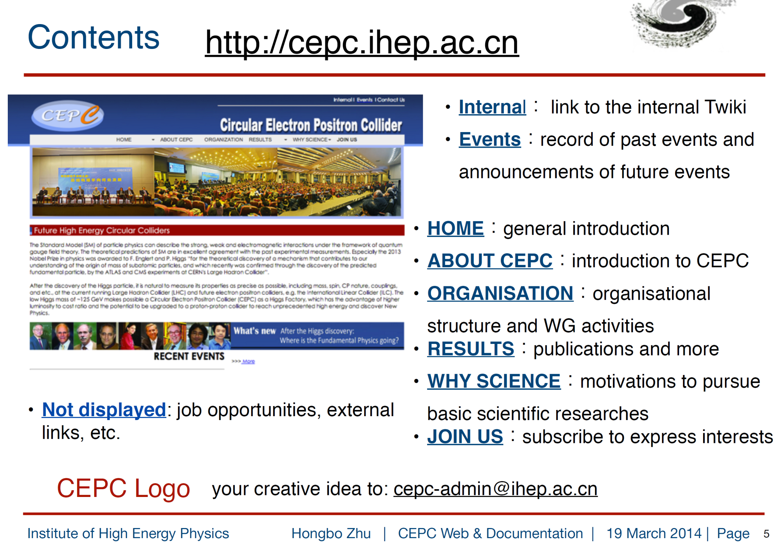
CEPC – Web & Documentation
中文版准备中

Slide 43
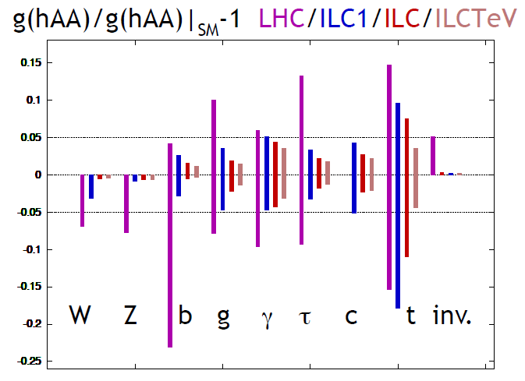
Circular e⁺e⁻ : Precision Higgs Machine
e⁺e⁻ Higgs Factory (240GeV) can more precisely measure Higgs properties
than LHC: Mass, J^{PC}, Couplings, especially h-ZZ, h-bb, h-ττ, couplings, and
invisible decays . It can also measure h-cc Coupling, which cannot be carried
out at LHC.
Most of important Precision-Higgs-Tests can be already done at HF(240GeV) , without ILC500. Higgs self-couplings’ll be probed at Super pp(50-100TeV).
M. E. Peskin,
arXiv:1207.2516
CEPC comparable to ILC1(250GeV)
Need verifications
(CDR,TDR)
HJ He

Slide 44
关于CEPC-SppC 的一些考虑
A circular Higgs factory fits our strategic needs in terms of
Science (great & definite physics)
Timing (after BEPCII)
Technological feasibility (experience at BEPC/BEPCII and other machines in the world),
Manpower reality (our hands are free after ~2020)
Economical scale (although slightly too high)
The risk of no-new-physics is complement by a pp collider in the same tunnel
A definite path to the future
A unique position for China to contribute at this moment:
Economical growth ➔ new funding to the community
Large & young population ➔ new blood to the community
Affordable tunnel & infrastructure
If no new project, no new resources ➔ It is a pity if we miss it
Y. F. Wang

Slide 45
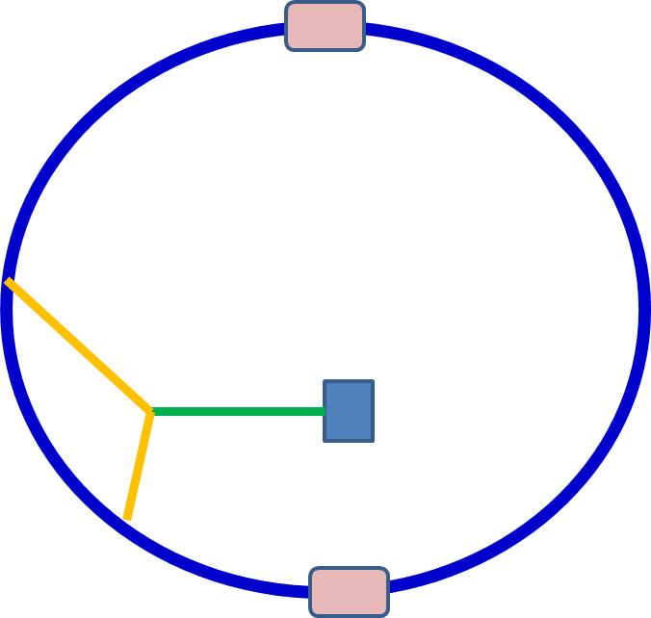
CEPC
CEPC –SppC “（多样化的）高能环形对撞机”
“Circular Electron Positron Collider”
环形正负电子对撞机
“Circular Electron Proton Collider”
环形电子质子对撞机
“Circular Proton-Proton Collider
环形质子质子对撞机
BEPCII后中国粒子物理加速器候选项之一

Slide 46
PRE-CDR & Feasibility Study
Kick-off meeting – September 12-13, 2013 (Beijing)
Organization
Working group meetings regular and numerous
Documentations and collaboration web site
Recruitment and training
Regular Steering Committee meetings (monthly)
Regular CEPC-SppC group workshops & meetings
2-3 times per year
CFHEP – get theoretical guidance
Schedule established for Pre-CDR by end of 2014
Initial considerations for TDR, construction, commission & operation

Slide 47

International Workshop Held in Beijing Dec. 16-17, 2013
The workshop will bring together people interested in circular high energy e⁺e⁻ colliders as a Higgs factory as well as a future circular high energy pp collider beyond the Higgs factory, and will discuss critical issues in accelerator technology, detector design and in theory on the precision measurement of the Higgs and the physics with pp collision at 50-100 TeV.
Monday, December 16, 2013
09:00 - 10:35 Session I
Convener: Prof. Xinchou Lou (IHEP, Beijing)
09:00 Welcome and Introduction 15' Speaker: Prof. Yifang Wang (IHEP)
09:15 Physics Opportunities 40'
Speaker: Prof. Nima Arkani-Hamed (Princeton)
09:55 The HL-LHC Physics Program 40'
Speaker: Dr. Takanori Kono (KEK/Ochanomizu)
10:55 - 12:05 Session II
Convener: Dr. Frank Zimmermann (CERN)
10:55 First Look at the Physics Case of TLEP 35'
Speaker: Prof. Alain Blondel (DPNC UNiversity og Geneva)
11:30 CEPC Machine Optimization and Final Focus Design 35'
Speaker: Dr. Dou Wang (IHEP)
14:00 - 15:45 Session III
Convener: Prof. Qing QIN (Institute of High Energy Physics)
14:00 Beam-beam Study of TLEP and Super-KEKB 35'
Speaker: Dr. Demin Zhou (KEK)
…….
First International CEPC Workshop
CERN FCC participation
Jump start the international coordination

Slide 48
Theory: Physics Cases for CEPC (E_{cm}≈240GeV, luminosity ~2×10³⁴ cm⁻²s⁻¹)
Light, weakly coupling H: M_{h}=125-126 GeV, Γ<1 GeV, spin ~0 (first)
Verification the 125 GeV boson is the SM Higgs
Precision measurement of the Higgs Boson
mass, width, couplings to final states;
look for deviations from the SM
Does the Higgs decay into something unexpected?
Are there more than 1 Higgs boson?
Use the Higgs boson to look for new physics
……
Higgs(~125 GeV) physics topics being identified and developed
by the Theory Group and CFHEP

Slide 49
Theory: Physics Cases for SppC (50-100 TeV pp collider L≈2×10³⁵cm⁻²s⁻¹)
By then, all all Higgs study and search for SUSY and Dark Matter has been conducted at the HL-LHC
It is a discovery machine
MSSM Higgs
Look out for new physics beyond the Standard Model
Search for WIMP and dark matter
Search for SUSY
……
See talks by Nima and Gordon

Slide 50
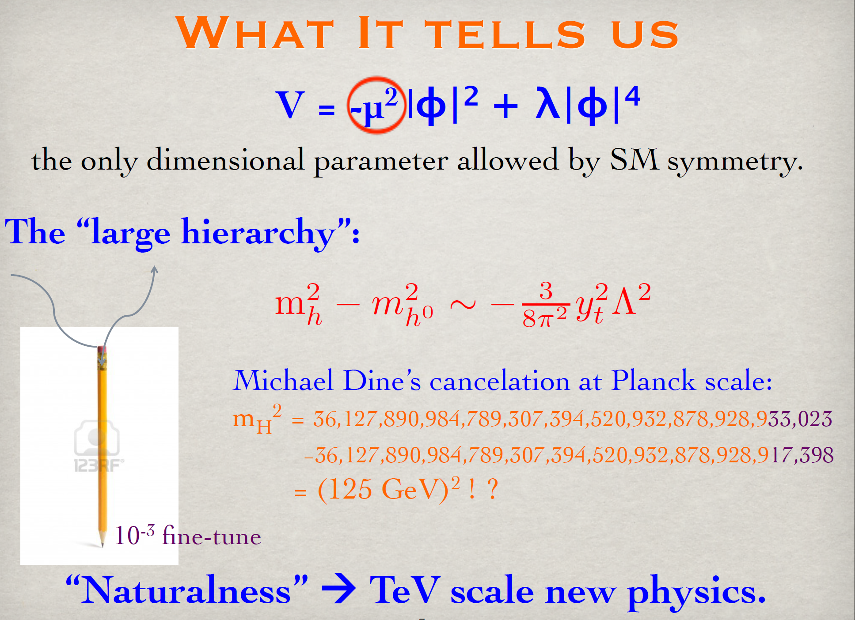
Borrowing from Tao Han Slides
T. Han
Notes:
All conceivable terms ~ natural coefficients; Lambda=cutoff energy scale, h=natural coefficient,

Slide 51
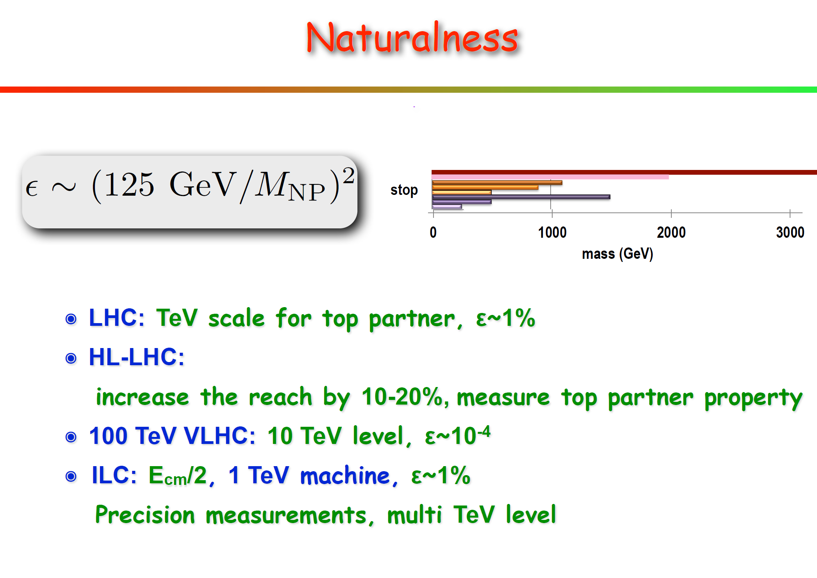
Physics Cases for SppC
S. Su

Slide 52
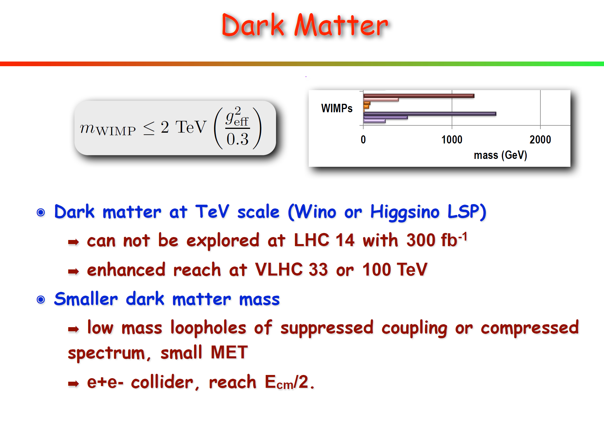
Physics Cases of SppC
S. Su

Slide 53
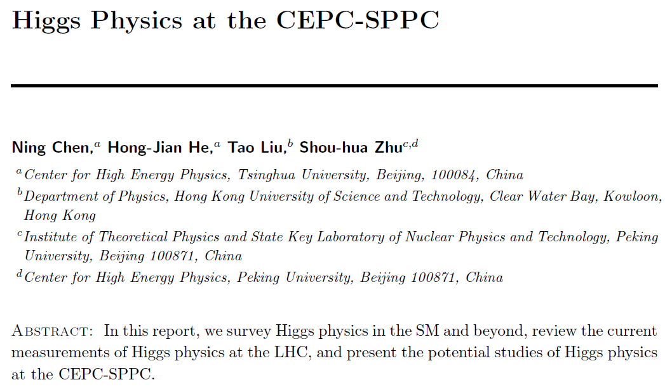
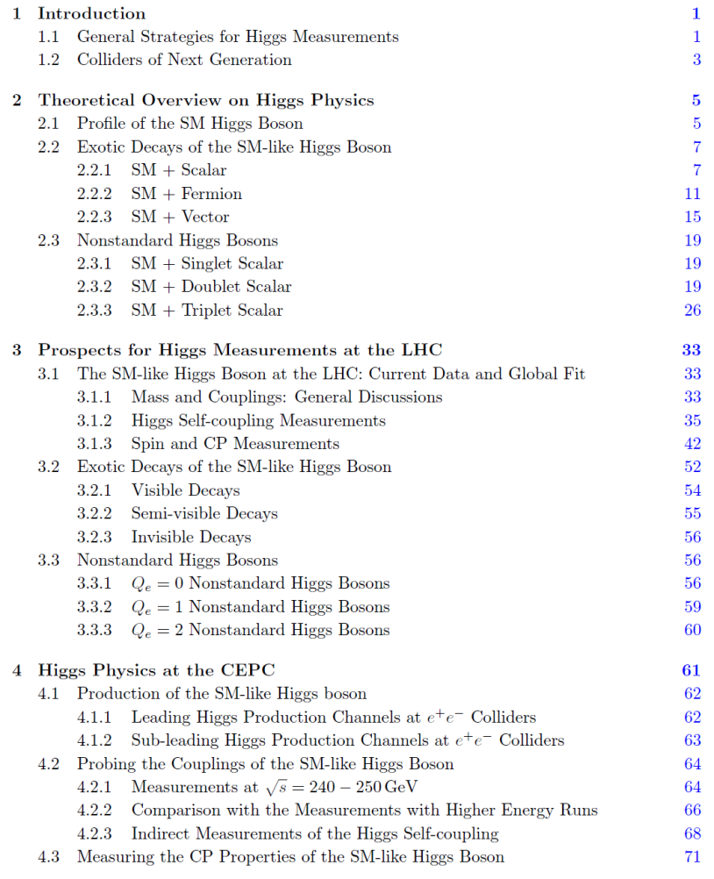
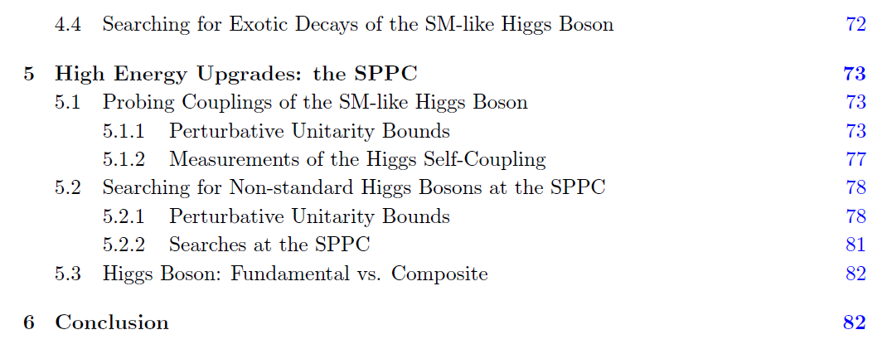
CEPC – theory effort
Great effort by Chinese theorists, (Hong-jian He & Shouhua Zhu)
Sub-groups formed
Meetings
Document " Higgs Physics at CEPC-SPPC " in progress

Slide 54
CEPC – current accelerator status
 | input
 | calculated
 | simulation results
preliminary parameters
Beam Parameters
Beam current [I] | mA | 16.60
Bunch population [N_{e}] |  | 3.71E+11
emittance-horizontal [ε_{x}] | m·rad | 6.79E-09
emittance-vertical [ε_{y}] | m·rad | 2.04E-11
coupling factor [κ] |  | 0.003
Beam length SR [σ_{s.SR}] | m | 0.00226
Beam length total [σ_{s.tot}] | m | 0.00258
Interation Point Parameters
Betatron function at IP-vertical [β_{y}] | m | 0.0012
Betatron function at IP-horizontal [β_{x}] | m | 0.8
Transverse size [σx] | μm | 73.70
Transverse size [σy] | μm | 0.16
Beam-beam parameter [ξ_{x}] |  | 0.104
Beam-beam parameter [ξ_{y}] |  | 0.074
Hourglass factor | Fh | 0.687
Lifetime due to Beamstrahlung-Telnov [τ_{BS}] | min | 2028
Lifetime due to Beamstrahlung [simulation] | min | 80
RF Parameters
RF voltage [Vrf] | GV | 6.87
RF frequency [frf] | GHz | 0.7
Harmonic number [h] |  | 125208
Synchrotron oscillation tune [ν_{s}] |  | 0.206
Energy acceptance RF [η] | % | 5.36
Synchrotron Radiation
SR loss/turn [U0] | GeV | 3.01
Damping partition number [Jx] |  | 1
Damping partition number [Jy] |  | 1
Damping partition number [Jε] |  | 2
Energy spread SR [σ_{δ.SR}] | % | 0.13
Energy spread BS [σ_{δ.BS}] | % | 0.07
Energy spread total [σ_{δ.tot}] | % | 0.15
Average number of photons emited per electron during the collision [nγ] |  | 0.22
Transverse damping time [n_{x}] | turns | 79.70
Longitudinal damping time [n_{ε}] | turns | 39.85
ARC Parameters
largest horizontal Betatron function [β_{xmax}] | m | 83
largest vertical Betatron function [β_{ymax}] | m | 83
largest horizontal size [σx] | mm | 0.7507
largest vertical size [σy] | mm | 0.0411

Slide 55
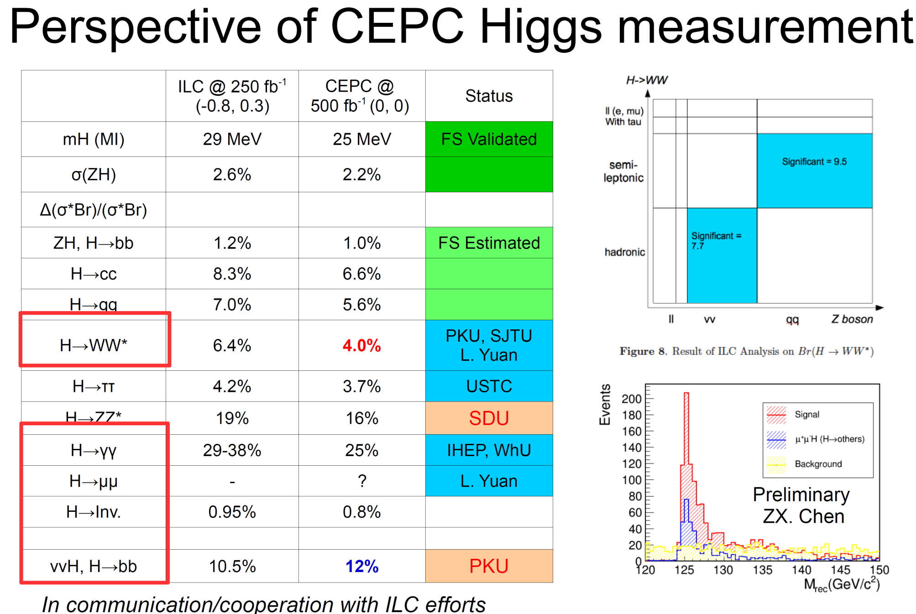
M. Q. Ruan

Slide 56
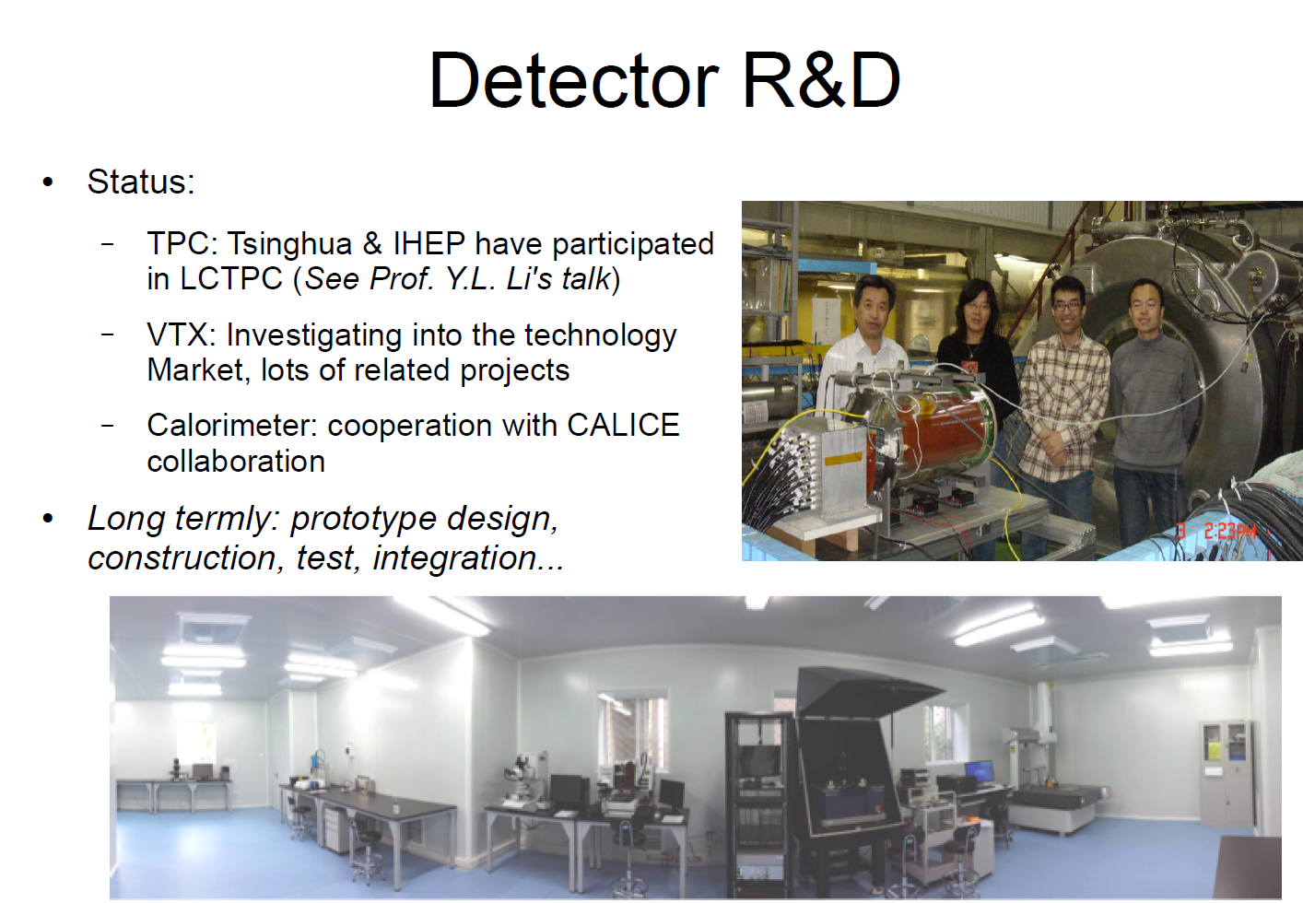
CEPC – Detector Considerations
M. Q. Ruan

Slide 57
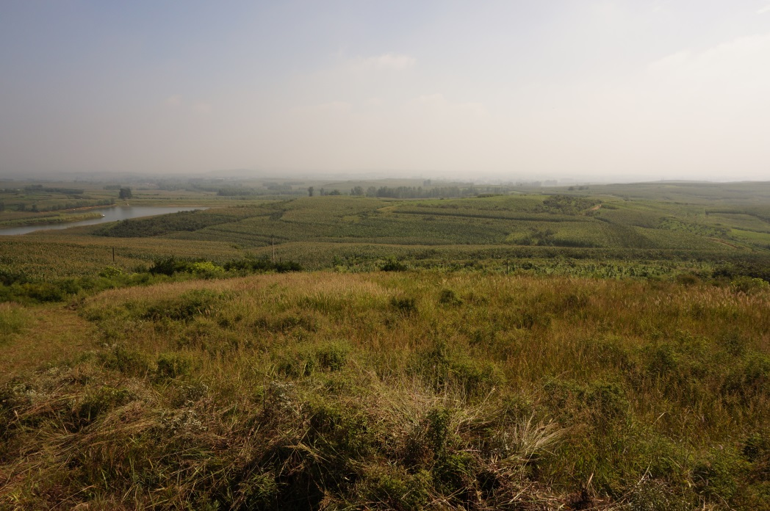
CEPC – Site Investigation Qinghungdao (秦皇岛)
Good geological condition
Base rock type: granite
Base rock depth: 0.5 - 2 m
Seismic intensity: no more than the level 7 (some damage to houses), 0.10g
Earth vibration(RMS, nm):
 | Zhangjiakou | Huailai | Qinhuangdao | Tianjing | Huairou
1~100hz | ~12 | ~40 | ~1.9 | ~470 | ~60
4~100hz | ~7 | ~14 | ~0.8 | ~24
Building the tunnel in granite will have the lowest cost
Y. F. Wang

Slide 58

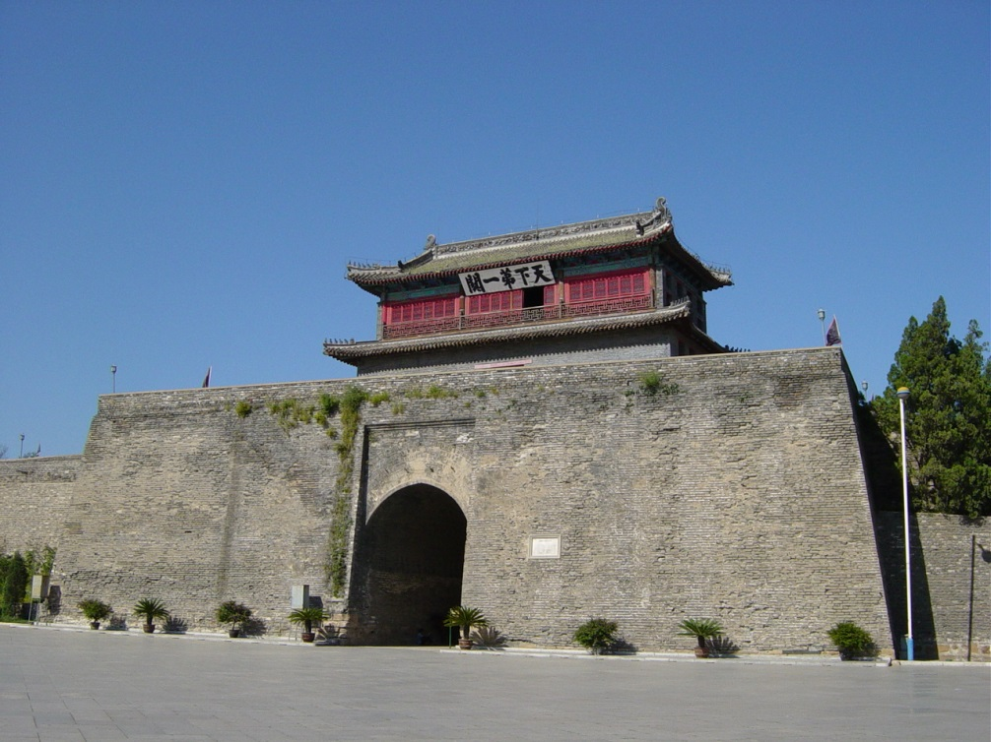

CEPC – Site Investigation Qinghungdao (秦皇岛)
Best beach & cleanest air
Summer capital of China
Starting point of the Great Wall
Wine yard
Y. F. Wang

Slide 59
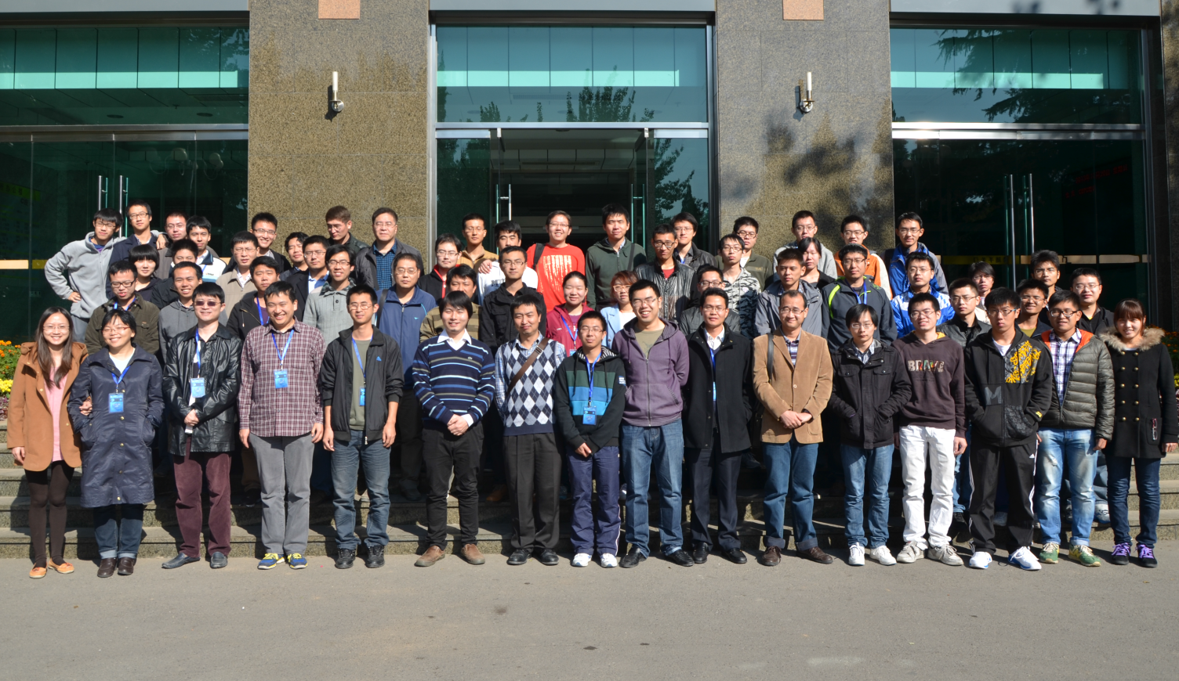
CEPC – Manpower Considerations
Training young people to address manpower shortage
Recruitment: postdocs and staff at IHEP
高能所卓越中心成立，着重提高博士后待遇

